Slide 1
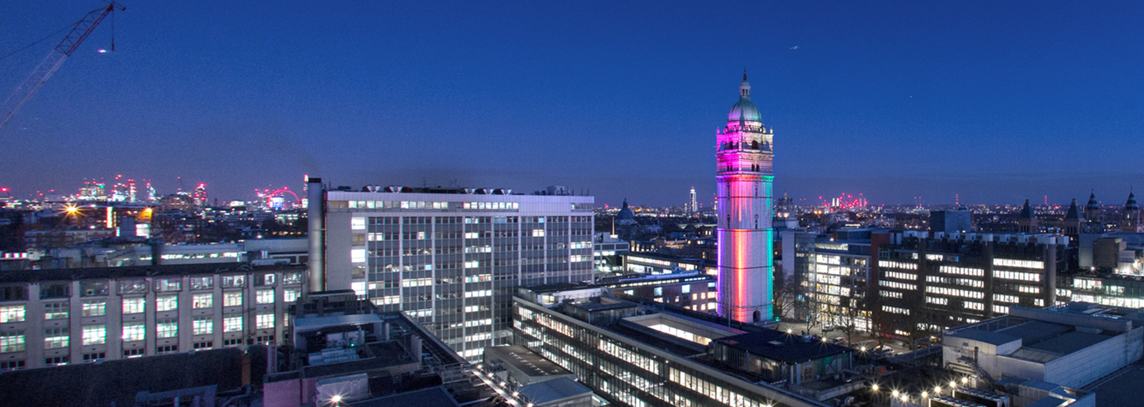

Customer:
Imperial College London
Industry:
Higher Education
Size:
8,000 employees
Country:
United Kingdom
Products and services:
Microsoft 365 Microsoft Teams
Microsoft Whiteboard
Microsoft Azure
Microsoft Azure Lab Services
Microsoft Azure Virtual Desktop Microsoft FastTrack for Azure
Windows 10 Enterprise
Read full story here
“We can have four or more users on one virtual machine, which means we only need 100 VMs in our pool. That’s one-quarter of what we’d need without Azure Virtual Desktop. This lets us be quite cost-efficient and far more scalable.”
—Neil Hanham, Digital Workplace Lead, Imperial College London
During the COVID-19 lockdown, Imperial College London had to provide 20,000 students remote classes and access to 450 proprietary apps installed on 3,500 on-campus computers.
Imperial uses Microsoft Azure Virtual Desktop for remote learning and Windows 10 Enterprise multi-session for high utilization of virtual machines (VMs), pooling four users per VM. Instructors configure special computer environments using Azure Lab Services.
Imperial provides remote learning in a Windows desktop environment that students can access regardless of their locations or device types. Using only one-quarter of the VMs normally required, it raises utilization while lowering compute costs.

